Slide 1
Smoking Cessation Brief Intervention Training For health professionals in cancer services
The 3As Brief Intervention

Slide 2
Welcome
Session objective
By the end of this session, participants will be able to confidently conduct a smoking cessation brief intervention, using the 3As model.

Slide 3
Section 1
Why deliver smoking cessation interventions to people with cancer?

Slide 4
Benefits of quitting tobacco use after a cancer diagnosis
Improves physical symptoms¹
Improves chances of survival¹
Reduces cancer treatment-related complications²
Improves anti-cancer drug effectiveness³
Improves treatment outcomes¹
Improves post-surgery healing²
1. US Dept Health, 2014; 2. Bjarnason et al., 2009; 3. Lu et al., 2006.

Slide 5
The risks of continued tobacco use after a cancer diagnosis
The cancer can become more aggressive^{4,5}
Increases the risk of the cancer spreading (metastasis)¹
Increases the risk of second primary cancer¹
61% increase in cancer-related mortality¹
42% increase in cancer recurrence¹
51% increased risk of all-cause mortality¹
US Dept.Health, 2014; 4. Sobus & Warren, 2014;
5. Warren & Singh, 2013.

Slide 6
Your role in smoking cessation
There is strong evidence that a brief intervention from a health professional can be effective in helping a patient to quit using tobacco⁶.
Trusted experts
Regular contact with patients
Patients listen to your advice
6. Stead et al., 2008.

Slide 7
Section 2
Delivering the 3As Brief Intervention

Slide 8
Section 2: The 3As Brief Intervention
What is a brief intervention?
Short and simple
Patient-centred
Facilitates patient behaviour change
There is strong evidence that a conversation of just a few minutes can improve the chances of a patient quitting tobacco⁶.
6. Stead et al., 2008.

Slide 9
The 3As Brief Intervention
ASK | ADVISE | ACT
Ask the patient if they have smoked/used tobacco in the last 30 days | Briefly explain the benefits of quitting and the risks of continuing to use tobacco after a cancer diagnosis | Refer the patient to the NSW Quitline
This model is for ALL patients.

Slide 10
Step 1: ASK

Slide 11
Asking the question
Empower patients to improve treatment outcomes
Ask respectfully and non-judgmentally
Support smokers who want to quit
“Have you smoked/used tobacco in the last 30 days?” should be asked as a matter of routine
Don’t assume a patient smokes
Provide information for patients to make an informed choice

Slide 12
Step 2: ADVISE
ADVISE = Briefly explain:
The benefits of quitting after a cancer diagnosis
The risks of continued tobacco use after a diagnosis

Slide 13
Step 2: ADVISE
Quitting smoking improves treatment outcomes¹
Cancer drugs are more effective when you quit³
Your chances of complications are reduced when you quit²
Continuing to smoke may make your cancer more aggressive^{4,5}
Continued smoking increases the risk of a second primary cancer¹
Tobacco smoke and nicotine can increase the chance of cancer spreading (metastasis)⁴
Choose the message that best suits your patient
1. US Dept Health, 2014; 2. Bjarnason et al., 2009; 3. Lu et al., 2006; 4. Sobus & Warren, 2014; 5. Warren & Singh, 2013.

Slide 14
Personalise the ‘ADVISE’ step
Consider your patient’s circumstances when you deliver the ‘Advise’ step. Make the information you provide relevant to:
their beliefs around their ability to quit
their beliefs around the benefits of quitting
the type and stage of their cancer
patients in palliative care
whether they are receptive to smoking cessation
cultural background

Slide 15
Smoking cessation in palliative care⁷
Improved sense of smell and taste
Reduced fatigue
Lower blood pressure
Improved breathing
Improved cognition
Reduced complications in end-of-life care
7. Leventakos et al., 2019.

Slide 16
Step 3: ACT
If you ask somebody about their tobacco use but don’t ACT by providing support to quit, they are less likely to quit than somebody you didn’t ask about their tobacco use⁶.
6. Stead et al., 2008.

Slide 17
ACT: Routine referral to Quitline
Refer the patient to the Quitline.
Fax referral form or use the online form.
Quitline will call the patient within two days.
Tools and resources to help patients quit.

Slide 18
The patient journey
Initial consult
Initial education session
Treatment review
Medical oncologist
Follow-up appointment
Radiation oncologist
Haematologist
Nursing staff and care coordinators
Medical oncologist
Nursing staff
Allied health staff
Radiation therapists
Radiation oncologist
Haematologist
Nursing staff
Allied health staff
Radiation therapists
Medical oncologist
Radiation oncologist
Haematologist
Nursing staff and care coordinators

Slide 19
Video: 3As Brief Intervention
https://education.eviq.org.au/rapid-learning/smoking-cessation

Slide 20
Section 3
Making a referral to Quitline

Slide 21
ACT: Routine referral to Quitline
Free, confidential phone service.
Increases the chance of a successful quit attempt^{8,9}.
Expert staff trained in smoking cessation for people with cancer.
Offers ongoing phone support.
Tools and resources to help patients quit.
Quitline will contact patients referred within two days.
Dedicated Aboriginal, Arabic, Cantonese, Mandarin and Vietnamese lines.
www.cancer.nsw.gov.au/quitline-referral
8. Matkin et al., 2019; 9. Hartmann-Boyce et al., 2019

Slide 22
What does ‘routine referral’ mean?
Routine referral is a model of care recommended by the Cancer Institute NSW.
You need to inform patients that you are making a referral, but don’t need their consent.
Explain that “we refer all patients who smoke”.
“I’m going to refer you to Quitline”.

Slide 23
Overcoming barriers to Quitline referral
Remind them of the benefits of quitting and the risks of continued tobacco use after a diagnosis
Let them know the Quitline is an effective support service they can use at any time
They might be ready for a referral next time

Slide 24
Making a referral to Quitline
Give the patient a smoking cessation brochure and Quitline referral card
Tell the patient you’re referring them to Quitline
Complete the referral form (online or fax)
Explain that Quitline will contact them within 2 days

Slide 25
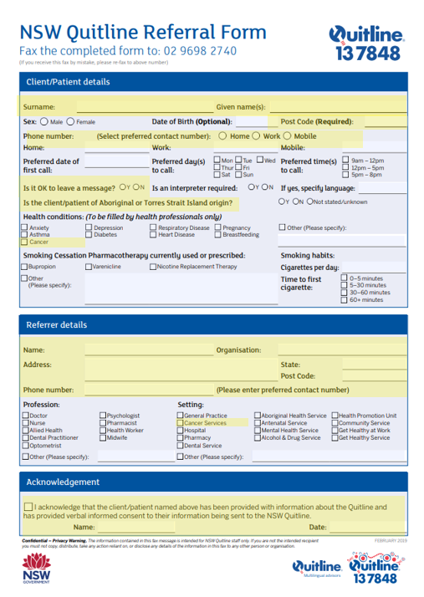

Slide 26
Your job is to get the patient to the first ledge of the ‘quit mountain’. Quitline supports them the rest of the way.
ACT: Quitline support

Slide 27
Section 4
Smoking cessation aids

Slide 28
Smoking cessation aids
Smoking cessation aids give your patients a better chance of quitting¹⁰.
Carbon monoxide monitors
Nicotine replacement therapy (NRT)
10. NSW Health, 2015

Slide 29
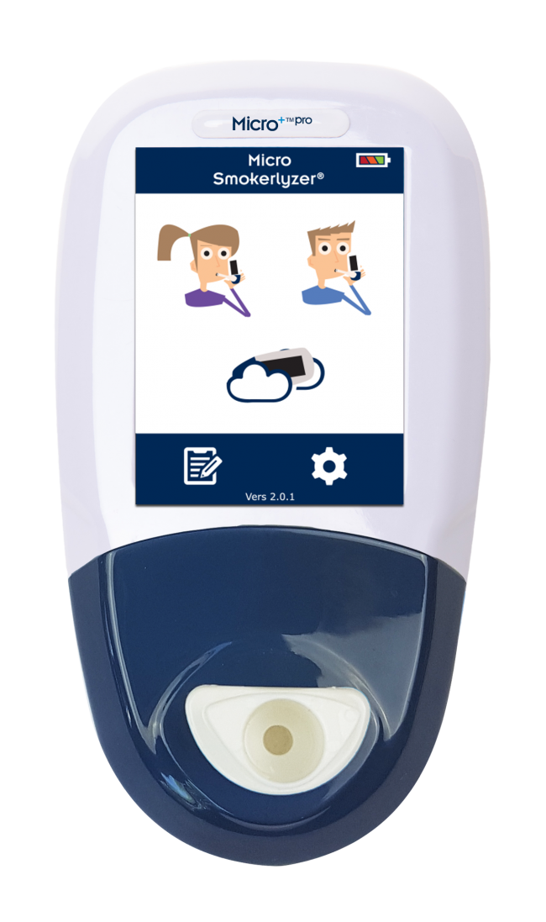
Carbon monoxide monitor
What is it?
Hand-held non-invasive monitor.
Shows the amount of carbon monoxide in a person’s breath and bloodstream.
Does not measure alcohol, cannabis or any other substances.
Use it as a motivational tool to show patients the effects of smoking (and quitting) on their carbon monoxide levels.

Slide 30
How to use a carbon monoxide monitor
Attach D-piece and plastic mouthpiece
Turn on the power button at the top
Press ‘Breath Test’ symbol on screen
Inhale and hold breath for 15 seconds; then count down
Blow slowly, emptying lungs
Explain result to patient using visual chart
Record results and remove D-piece
Use non-alcoholic wipes to clean

Slide 31
Nicotine replacement therapy (NRT)
Patches
Gum
Inhalers
Lozenges
Mouth spray
Reduce cravings and withdrawal symptoms by providing nicotine without the harmful components of tobacco.¹⁰
10. NSW Health, 2015

Slide 32
Using nicotine replacement therapies
NRT can increase the chances of a successful quit attempt by 50 to 60%¹¹
Combining NRT with a telephone support, such as Quitline, gives the best results.⁹
9. Hartmann-Boyce et al., 2019; 11. Hartmann-Boyce et al., 2018.

Slide 33
Section 5
Skills practice: Delivering the 3As Brief Intervention

Slide 34
Skills practice
Case study 1
Jim
Case study 2
Julie

Slide 35
Delivering the 3As Brief Intervention
ASK: Have you smoked/used tobacco in the last 30 days?
ADVISE: The benefits of quitting, and the harms of continuing to smoke after diagnosis.
ACT: Refer to Quitline.
Personalised
Non judgemental
Compassionate

Slide 36
3As Brief Intervention review
ASK | ADVISE | ACT
Primary question: “Have you smoked/used tobacco in the last 30 days?” (including cigarettes, waterpipe, cigars, cannabis with tobacco) Follow-up questions: “Do you smoke daily or occasionally?”(<30 days) “Have you ever smoked tobacco?” | “Giving up smoking can help your cancer treatment work better.”¹ “Quitting smoking increases your chances of survival.”¹ “Quitting now reduces the chance of complications.”² “Tobacco and nicotine can make cancer more aggressive.”⁴ | “We refer all cancer patients who smoke to NSW Quitline.” “It’s easy for me to make a referral on your behalf and they will be in contact with you in the next 48 hrs.” “Using a phone support service like Quitline can increase your chances of quitting by up to 60%. I’ll refer you now.”
1. US Dept Health, 2014; 2. Bjarnason et al., 2009; 4. Sobus & Warren, 2014.

Slide 37
Case study 1: Jim
Jim is a 57-year-old retired builder who has recently been diagnosed with lung cancer. Jim has smoked 10 to 15 cigarettes a day since the age of 20 and has had many previous quit attempts. Jim has been visiting the hospital frequently and thinks that because he has a cancer diagnosis, the damage of smoking is already done and it’s not worth giving up now.

Slide 38
Case study 2: Julie
Julie is a 35-year-old woman who was diagnosed with breast cancer a year ago. Julie smokes 15 to 20 cigarettes a day. Julie lives alone and has not previously shown interest in quitting smoking. When asked about her smoking status, Julie gets hostile. She doesn’t understand what this has to do with her treatment.

Slide 39
Summary
Learning review
Why smoking cessation is important in cancer services
The benefits of quitting tobacco after a cancer diagnosis
The impacts of tobacco use after a cancer diagnosis
How to deliver the 3As Brief Intervention
Making referrals to Quitline
Using a carbon monoxide monitor
Advising patients on the use of NRT

Slide 40
Next steps
Review your notes and handouts
Deliver the 3As Brief Intervention to all patients
Complete the training evaluation sheet
Thank you

